Slide 1


Analysis of the global pandemic—
concerning the cases and deaths
Team 1
Yunhao Yang
Liuyi Bao
Jun Wei
Xiaoyi Xu

Slide 2
Outline
Introduction
Data Cleaning
Descriptive analysis
Inferential analysis
Regression model
Causal interpretation
Questions to address
Summary

Slide 3
Introduction
About Dataset: 100725 observations and 8 different variables.
Quantitative variables：New_cases, New_deaths, Cumulative_cases,Cumulative_deaths
Categorical variables: Country,Country_code,WHO_region, Date_reported
Questions of interest
How the number of new cases and new deaths change with the time in each region？
Whether there is any differences in new cases and new deaths each month between different regions?
How can we describe the relationship between new cases and new deaths?

Slide 4
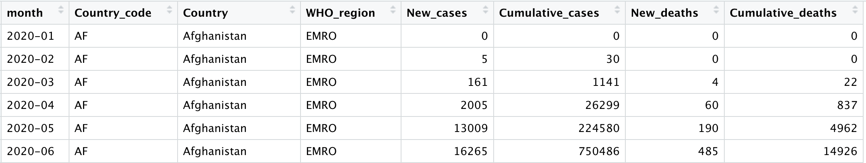
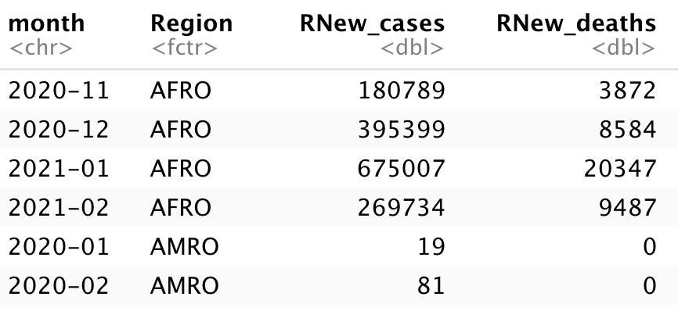
Data Cleaning
Data: Create monthly dataset with sum of each quantitative variables, filter the Date_reported in March.
Data_region: The monthly dataset are cutted in region.

Slide 5
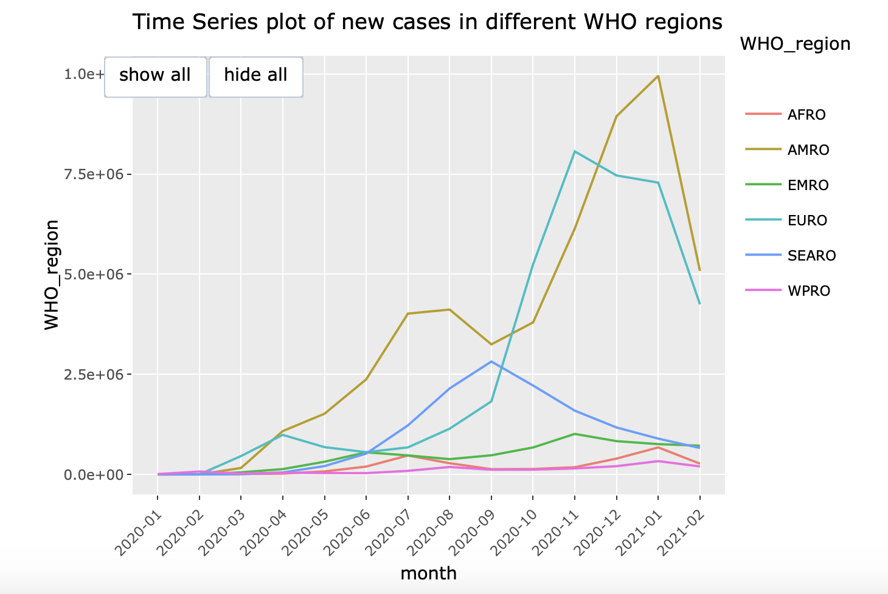
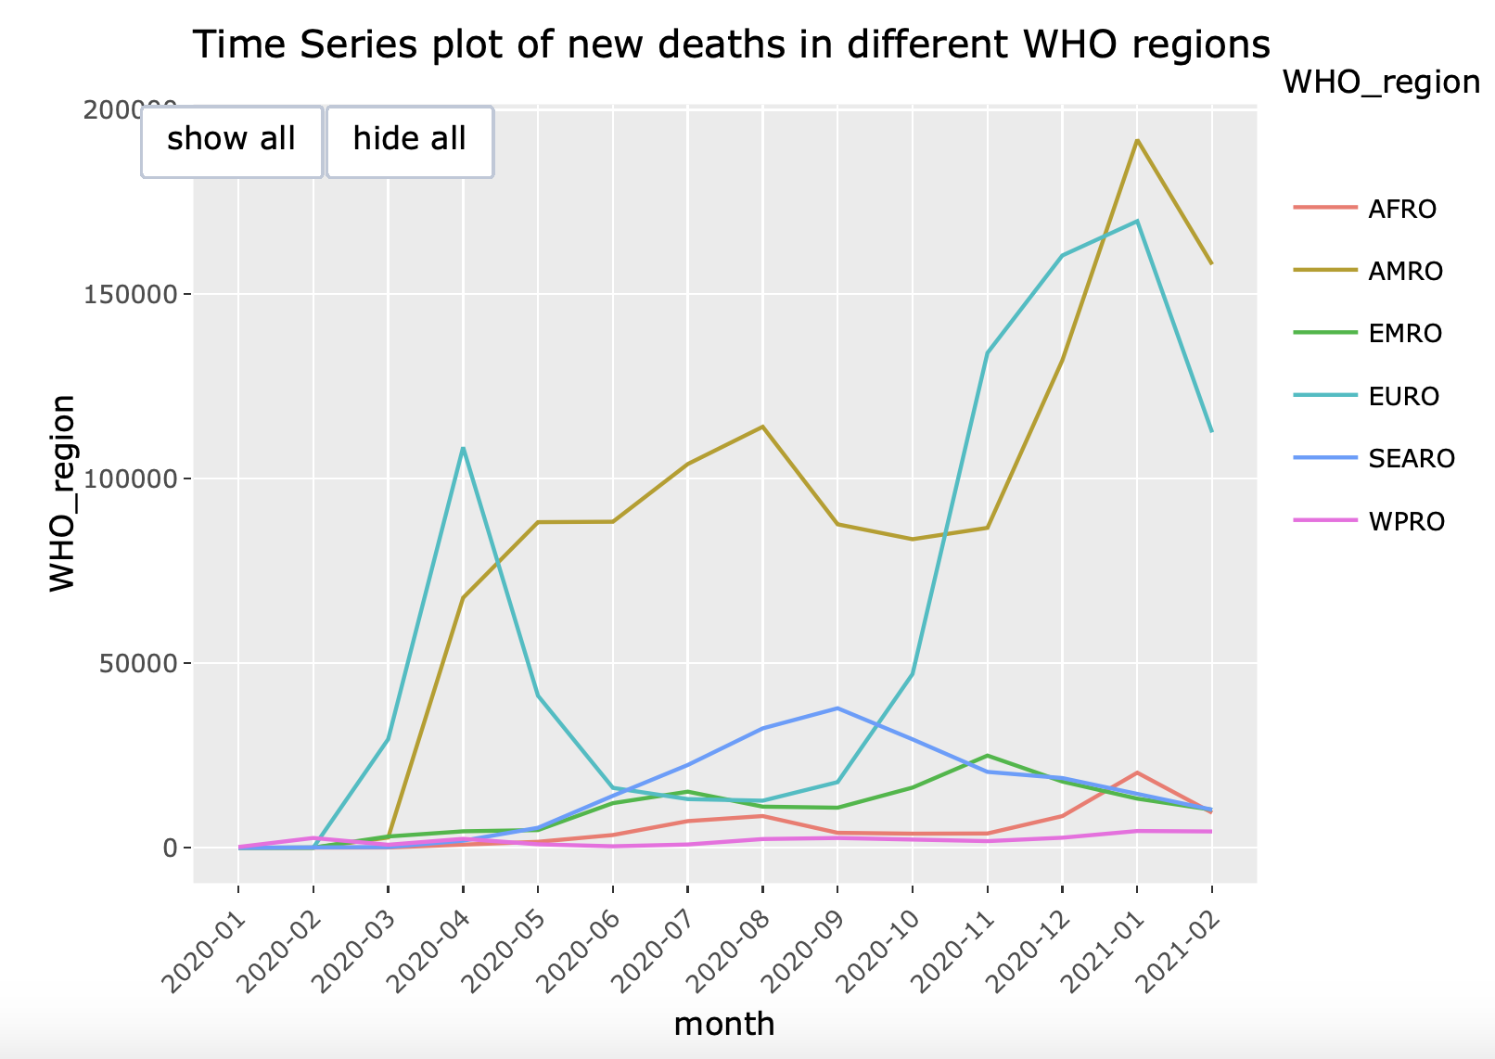
Descriptive analysis
AMRO
Q1: How the number of new cases and new deaths change with the time in each region？
Africa
Africa
East Asia Americas
East Asia
Americas
Americas
Similar trend

Slide 6
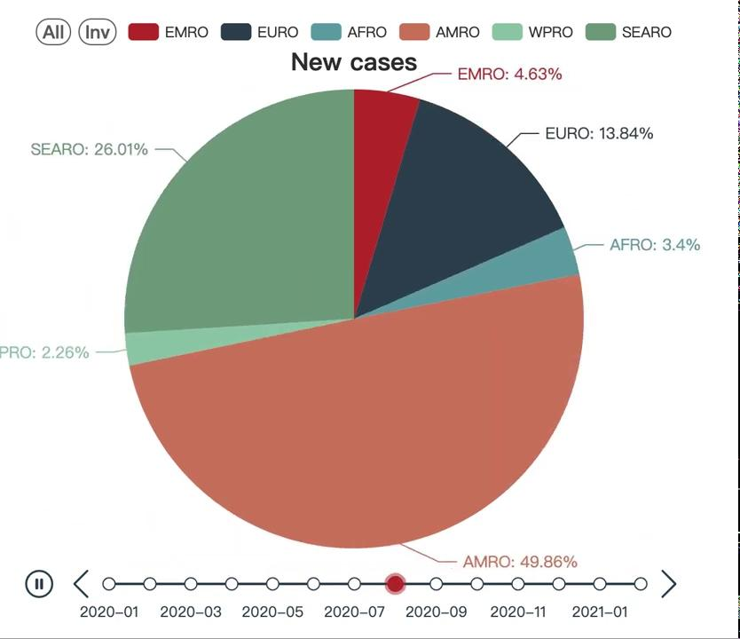
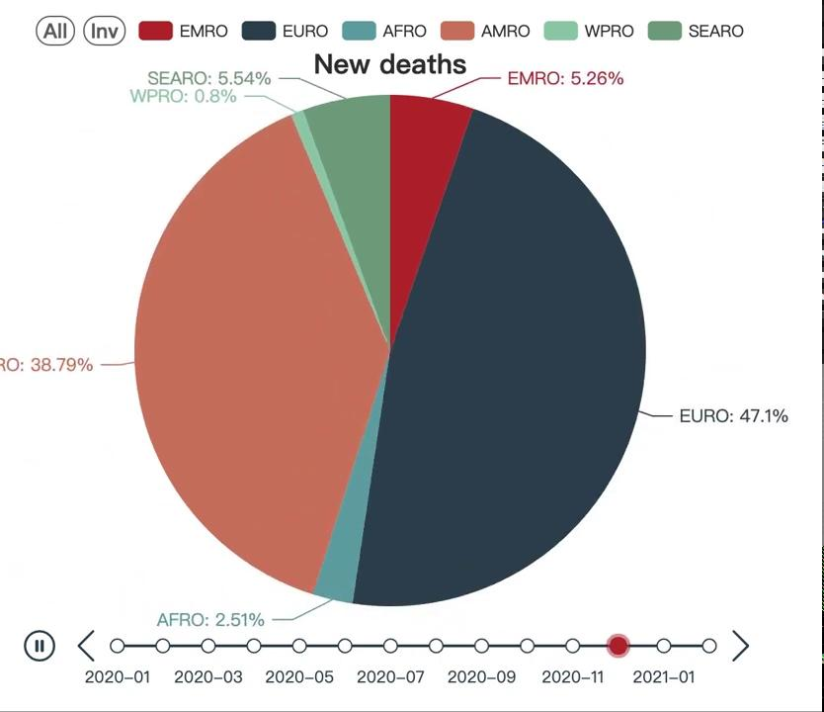
Descriptive analysis
Q2: Whether there is any differences in new cases and new deaths each month between different regions?

Slide 7
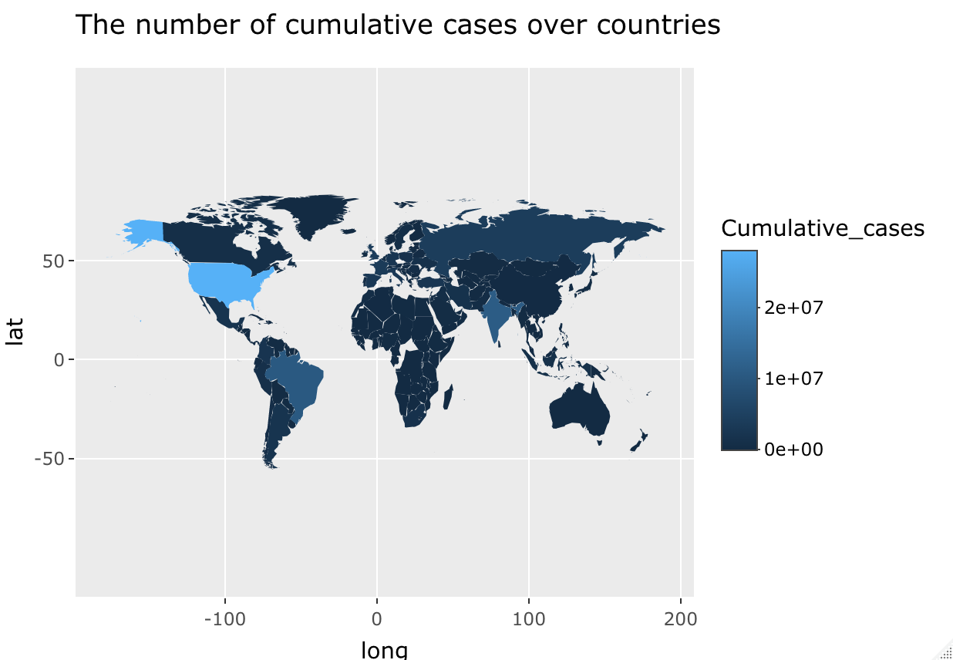
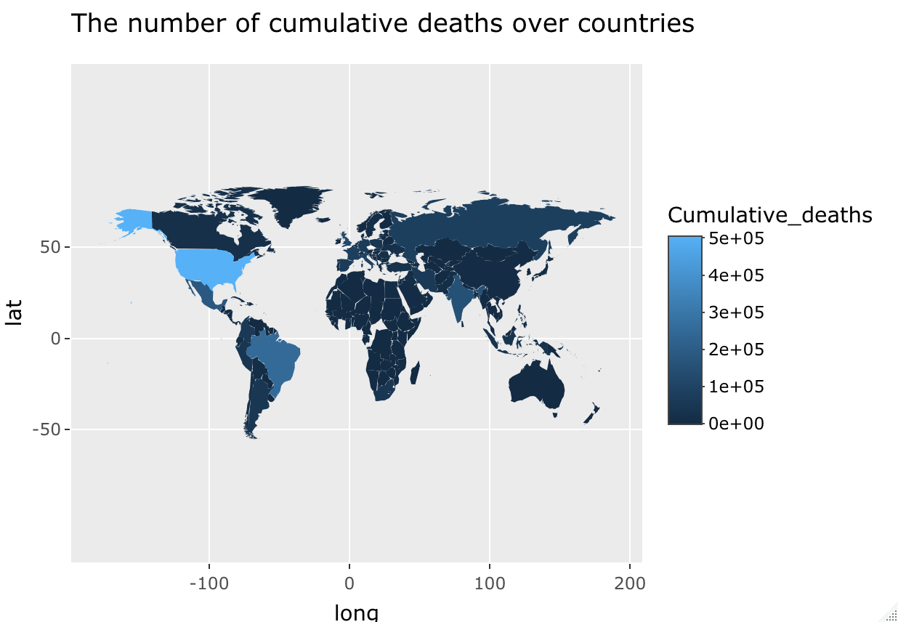
Descriptive analysis
Brazil
Brazil
India
India
The United State
The United State

Slide 8
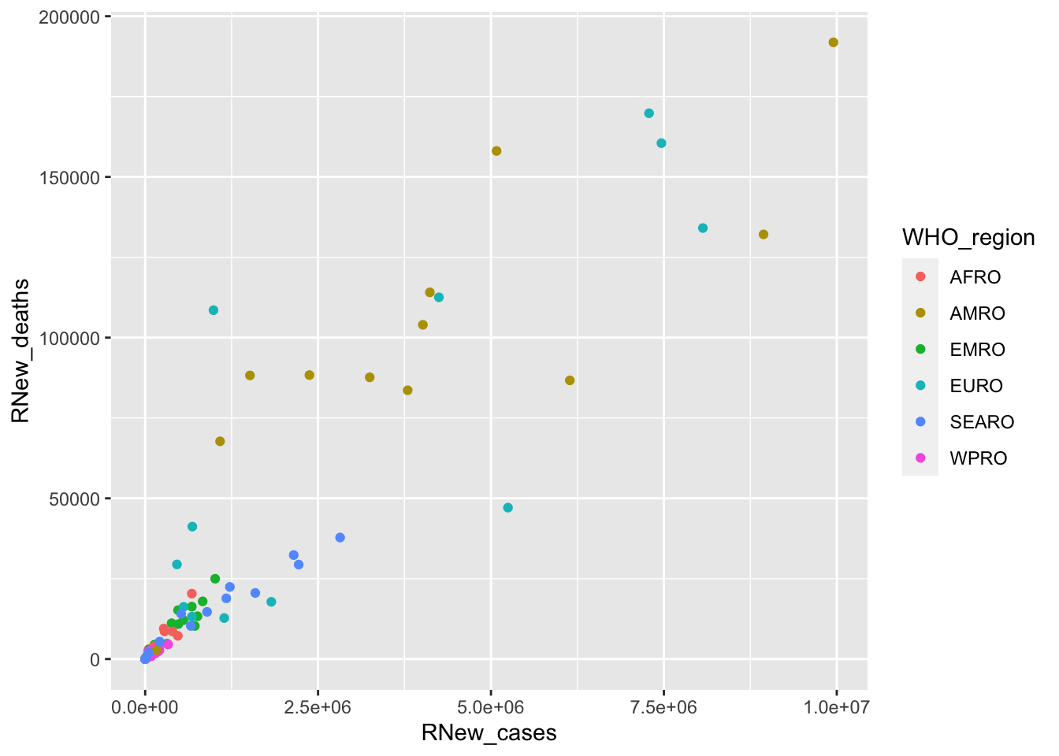
Inferential analysis—— Regression Model
Q3: How to describe the relationship between new cases and new deaths

Slide 9
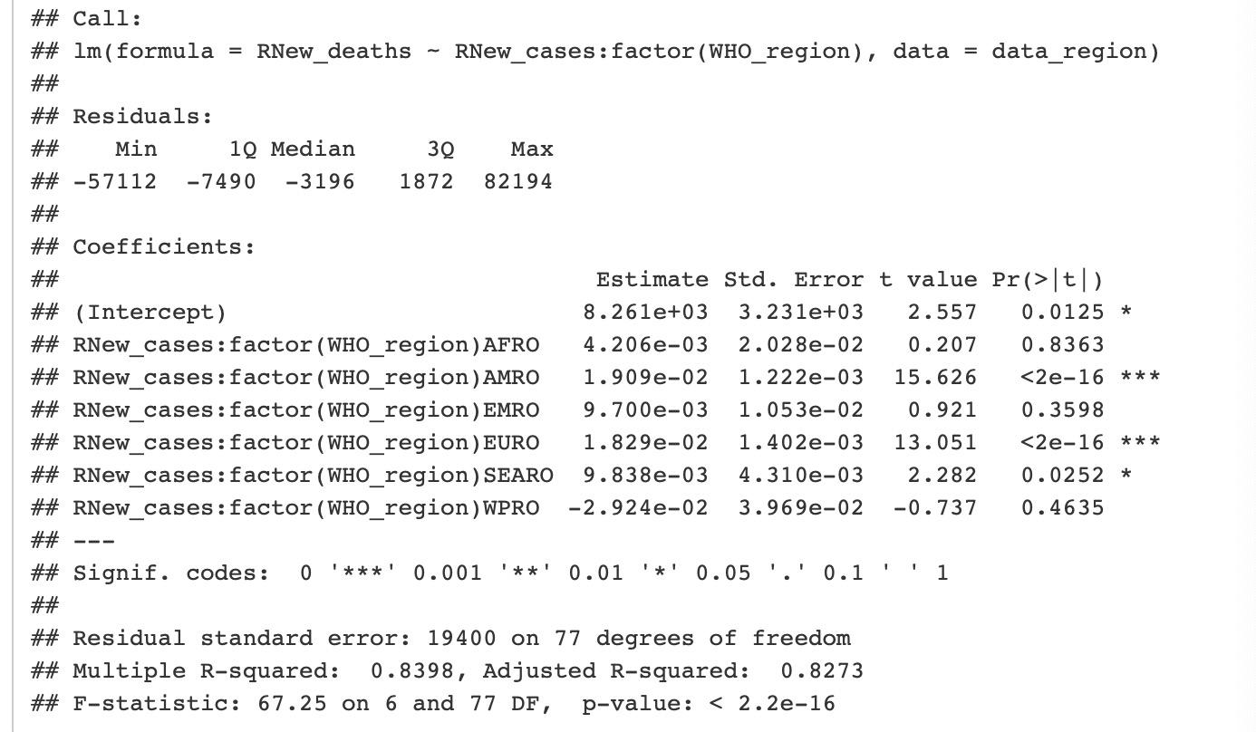
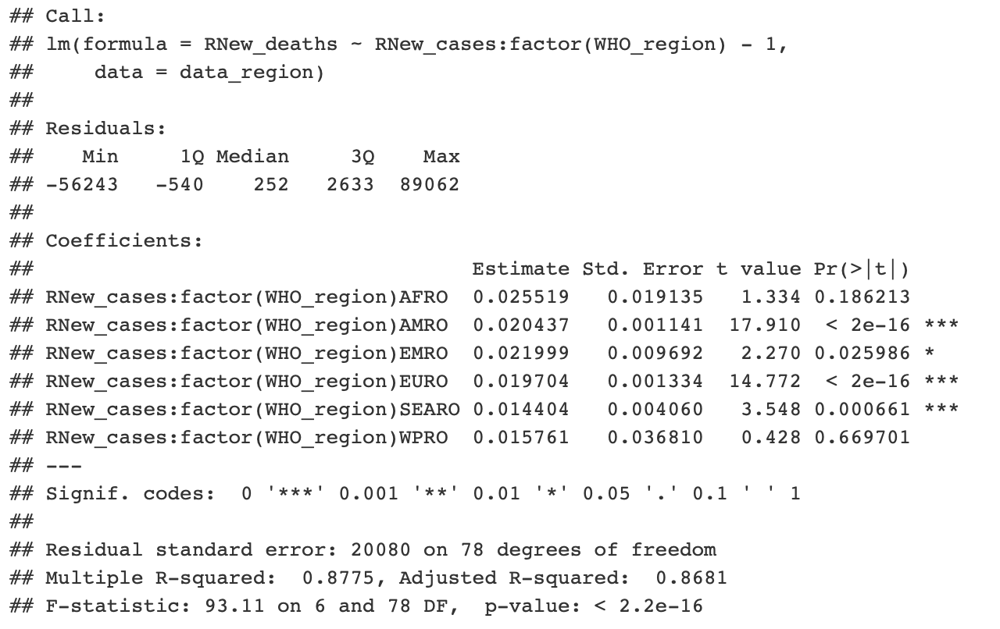
Inferential analysis—— Regression Model
l

Slide 10
Inferential analysis—— Regression Model
model form:

Slide 11
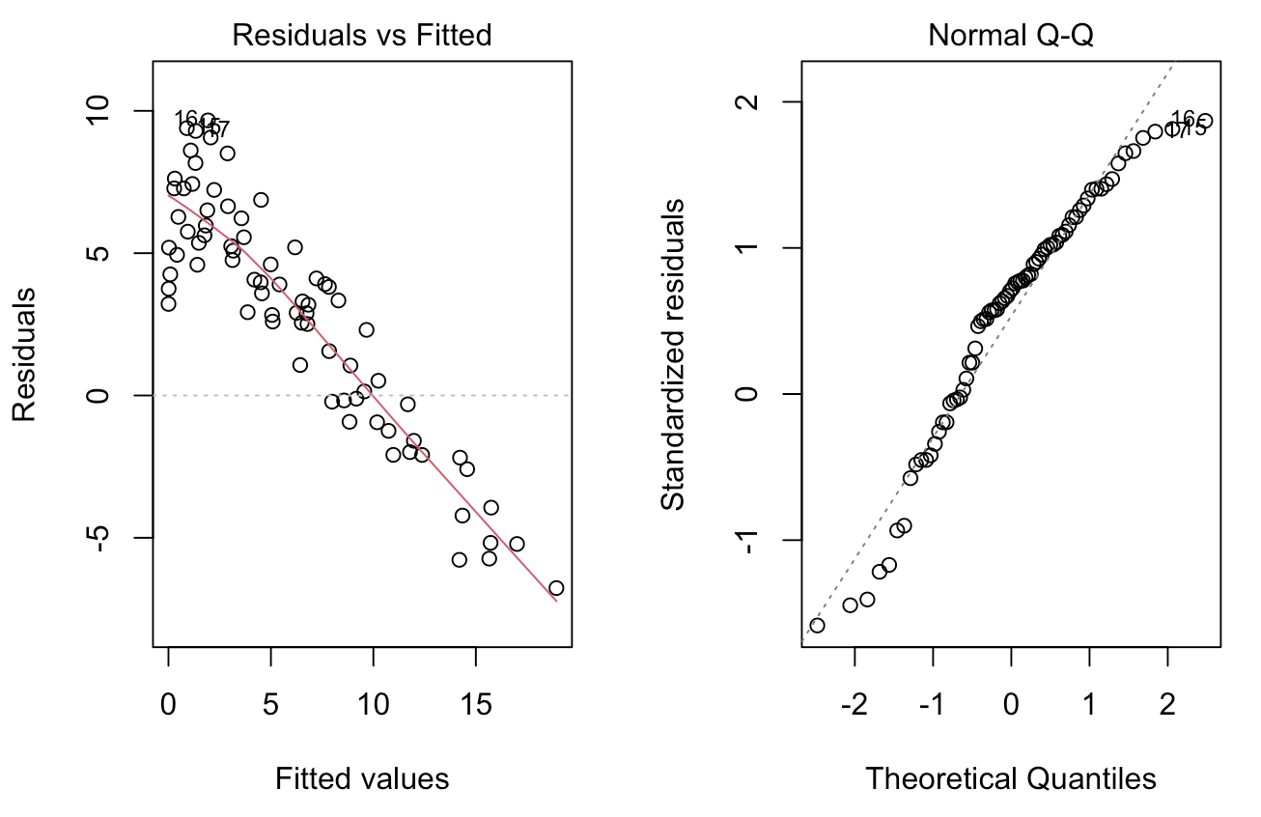
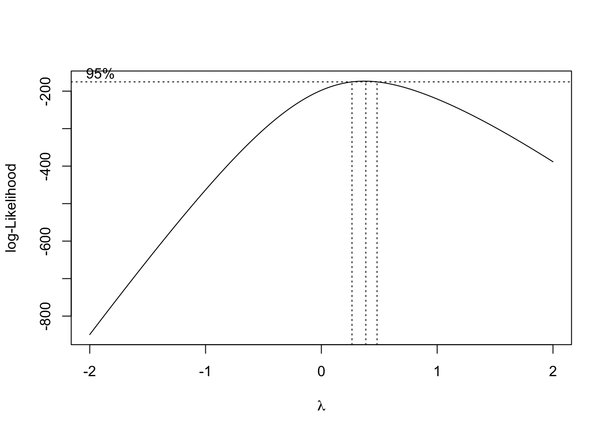
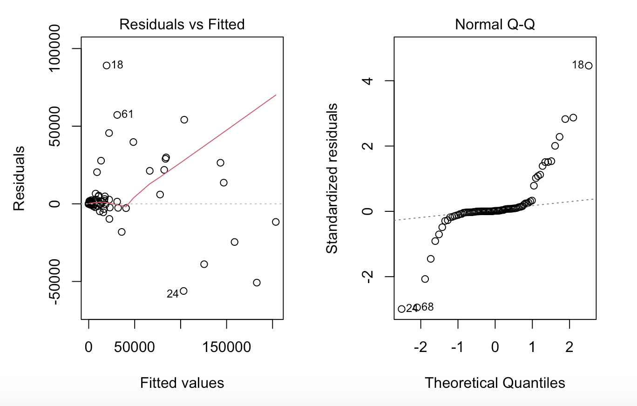
Inferential analysis—— Diagnosis

Slide 12
Inferential analysis
Inferential analysis—— Regression Model
Final model:

Slide 13
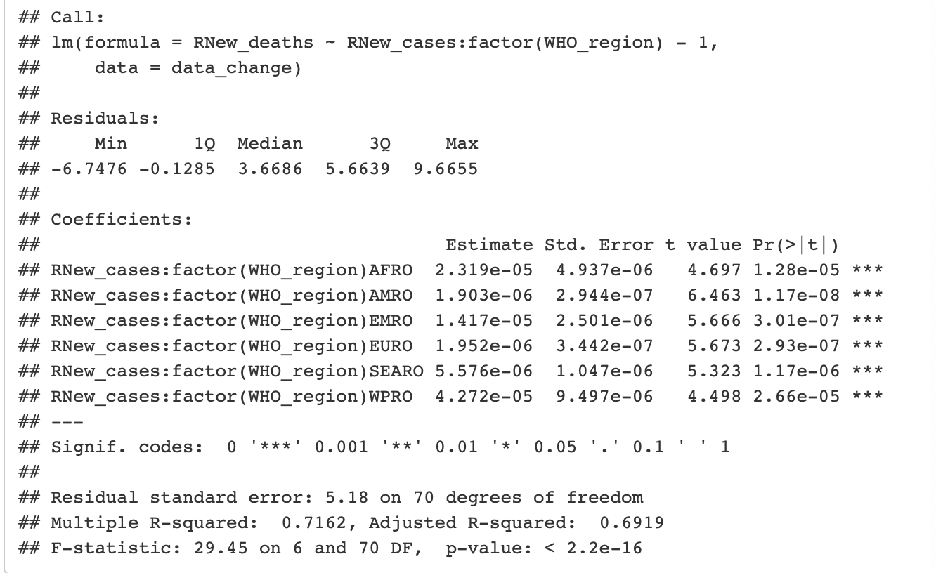
Inferential analysis—— Regression Model

Slide 14
Causal interpretation
Unable to draw the conclusion about causal relationships
Association: monthly new cases and monthly new deaths(same trend but different in different regions)

Slide 15
Questions to address
Why do we use the monthly data over regions?
Why do we drop the variables about time in linear model?

Slide 16
AMRO
Africa
Africa
East Asia Americas
East Asia
Americas
Americas
Similar trend

Slide 18
Questions to address
How can we explain the association between new deaths and new cases?
Why can’t we draw the conclusion about casual relationships?
How can we improve our model or report?

Slide 19
Summary
Achievements
--project
Question 1: visualization plots
Question 2: ANOVA model
Question 3: multiple regression model
--presentation
Shortcomings and improvements
Basic assumptions
More data and more variables

